Slide 1


PAAVAI ENGINEERING COLLEGE
AUTONOMOUS
DEPARTMENT OF INFORMATION TECHNOLOGY
MOBILE APPLICATION FOR REAL ESTATE
FINAL REVIEW
BATCH NO:18
GUIDED by:
Mrs.M.Pushpalatha,M.E.,
Associate Professor ,
Department of IT,
Paavai Engineering College
PRESENTED by:
M.VASEEKARAN(202020057)- IV/IT
S.SELVAMANI(20202048)-IV/IT
S.GUNASEELAN(20202020)-IV/IT
Paavai Engineering College

Slide 2
OUTLINE
Introduction Objective Technology used Existing system Proposed system Block Diagram Results
Conclusion References

Slide 3
Introduction
In today's digital age, mobile application development plays a pivotal role in various domains, providing tailored solutions to meet the diverse needs of users.
One such critical domain is the real estate industry, where mobile applications serve as indispensable tools for property search, evaluation, and transaction management.
This introduction delves into the significance of mobile applications in real estate, highlights the challenges faced, and underscores the importance of developing a robust platform for property management.

Slide 4
Objective
Develop a user-friendly interface that allows users to easily search for properties..
Implement push notifications to alert users about new listings that match their search criteria, price reductions, open houses, and other relevant updates in real-time
Utilize Flutter's cross-platform capabilities to develop a single codebase that can run seamlessly on both Android and iOS devices, maximizing reach and accessibility for users.

Slide 5
Technology used
HARDWARE REQUIREMENTS
Processor : Intel processor 2.6.0 GHZ
RAM : 4 GB (MIN)
Hard disk : 20 GB
Operating system : Android
SOFTWARE REQUIREMENTS
IDE : Andriod studio
Back end : Firebase
Programming : Flutter SDK
OS : Windows 11 or 10
Database : Firebase
Testing tools : Mockito

Slide 6
Existing system
In the existing system of mobile application development for real estate in Flutter, developers typically rely on a combination of various tools, frameworks, and methodologies to create functional and user-friendly applications..
The existing system often involves utilizing Flutter's extensive widget library to create visually appealing and responsive user interfaces tailored to the real estate industry's needs

Slide 7
Proposed system
Implement algorithms to provide personalized recommendations to users based on their search history, saved preferences, and behavior within the app.
Use machine learning techniques to analyze user data and suggest relevant properties that match their interests and requirements
Additionally, enable push notifications to keep users informed about new listings that match their saved searches, price drops on saved properties, upcoming open houses, or messages from agents.

Slide 8
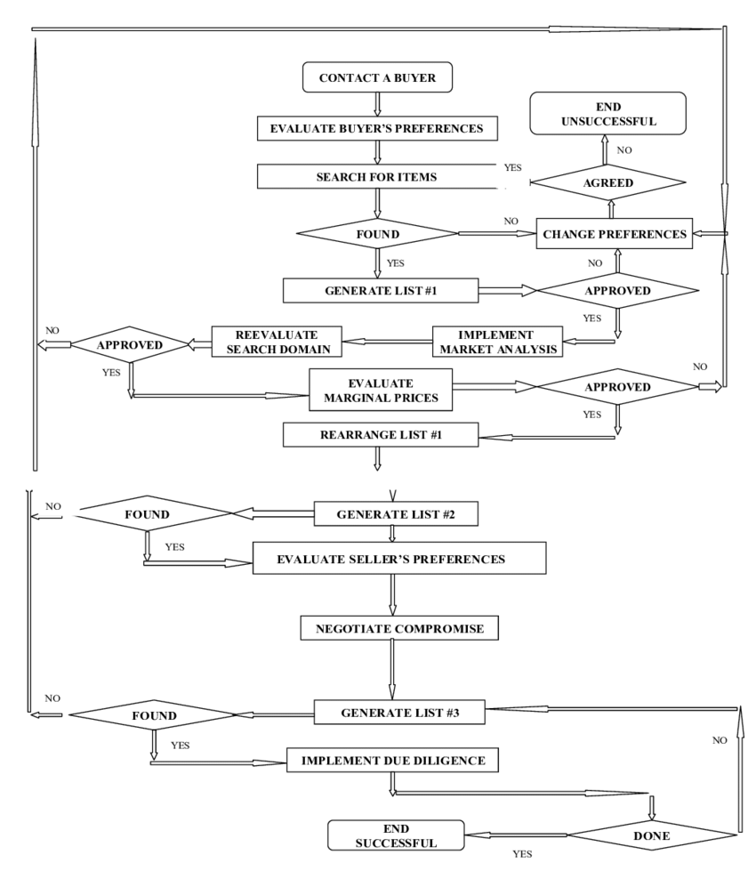
Block Diagram

Slide 9
Features
For future enhancement and scalability of a mobile application developed for real estate in Flutter, several avenues can be explored to improve user experience, expand functionality, and accommodate growing demands
Offer personalized recommendations and custom search preferences based on user behavior, preferences, and past interactions with the app. Personalization enhances user satisfaction and increases engagement

Slide 10
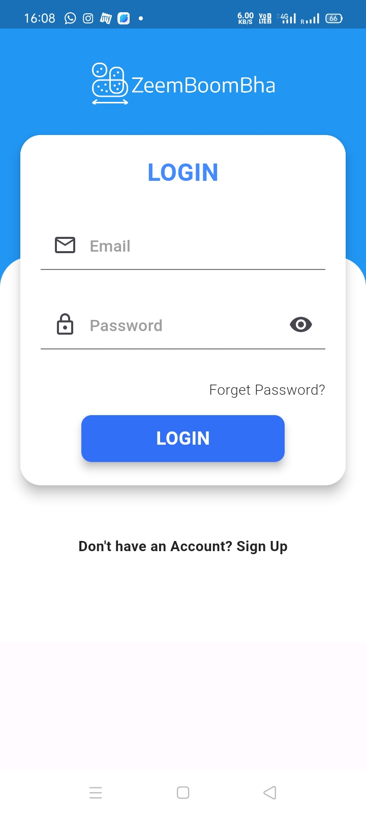
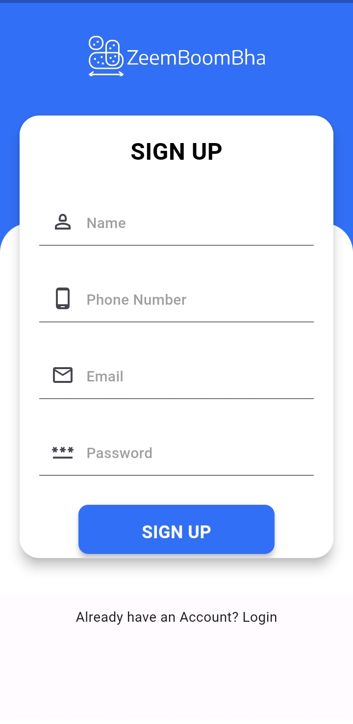
USER LOGIN
SIGN UP

Slide 11
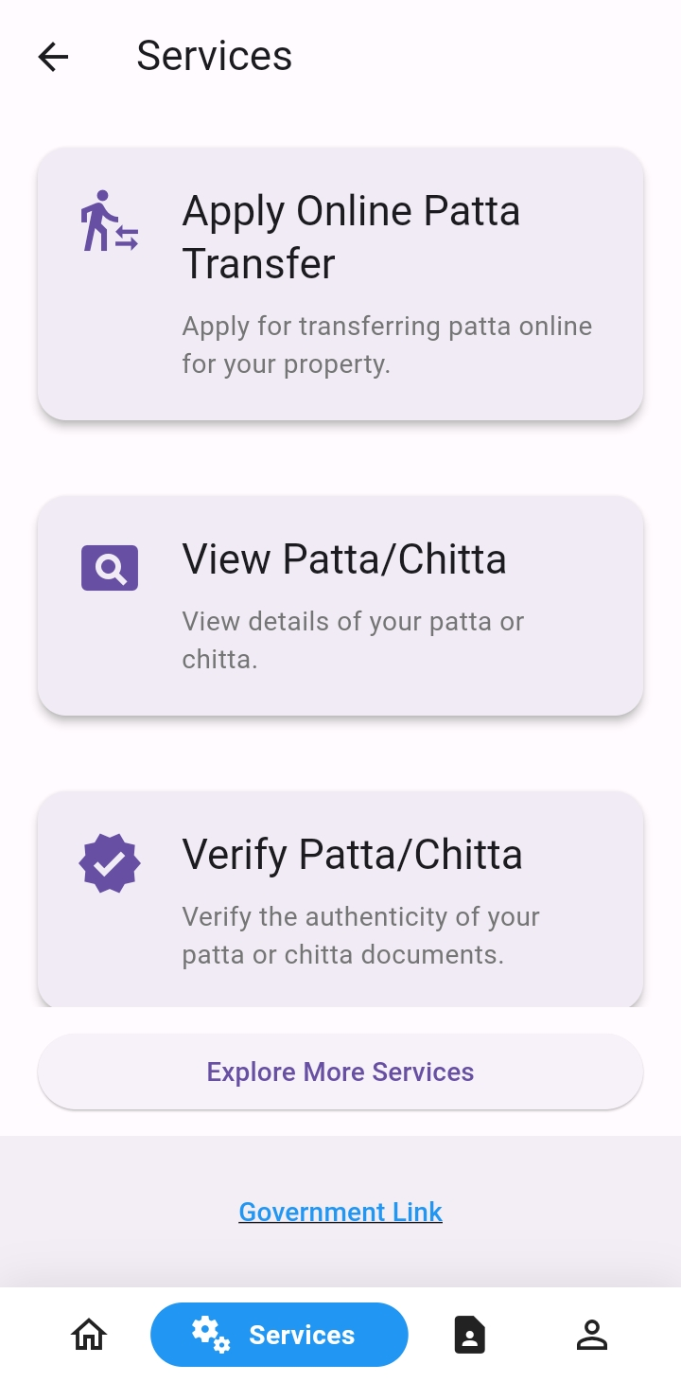
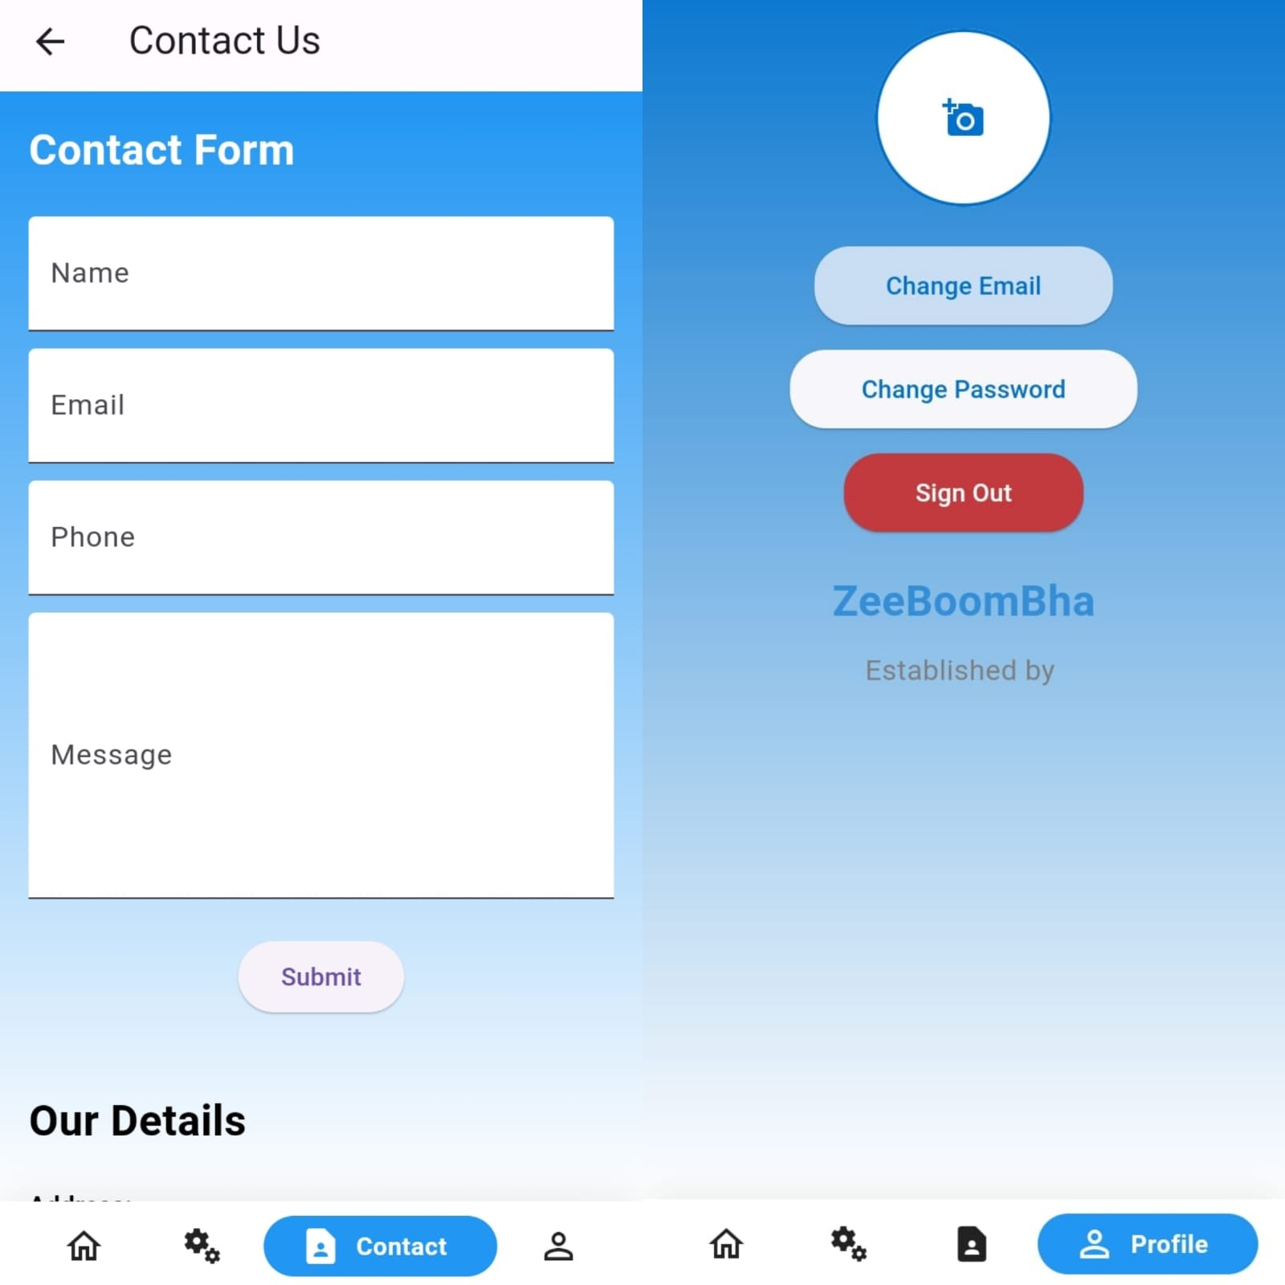
SERVICES
QUERY

Slide 12
Conclusions
The development of a mobile application for real estate in Flutter presents a transformative opportunity to revolutionize the way individuals interact with the real estate market.
With features such as property listings, search filters, interactive maps, and secure payment gateways, the application empowers users to navigate the real estate landscape with ease and confidence.

Slide 13
References
Applications, Opportunities and Challenges of AI in the Real Estate Sector, Ricardo Ribeiro, João Antão 2024
Artificial intelligence algorithms to predict Italian real estate market prices, Luca Rampini Fulvio Re Cecconi 2024
Blockchain in real estate: Recent developments and empirical applications Anniina Saari Jussi Vimpari 2023
Mobile CRM development for real estate agents, Ruben Pereira, Ricardo Ribeiro, 2022

Slide 14
Thank You

